Slide 1
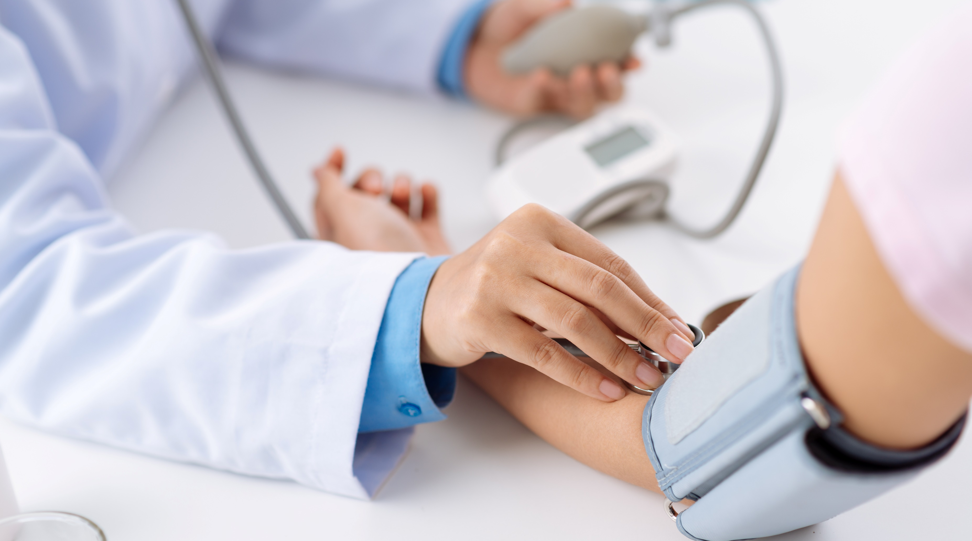
Prediction
System
AI based diabetes

Slide 2

Name: K.Valarmathi
Branch: BIO medical
Engineering
Year: 3rd year

Slide 3
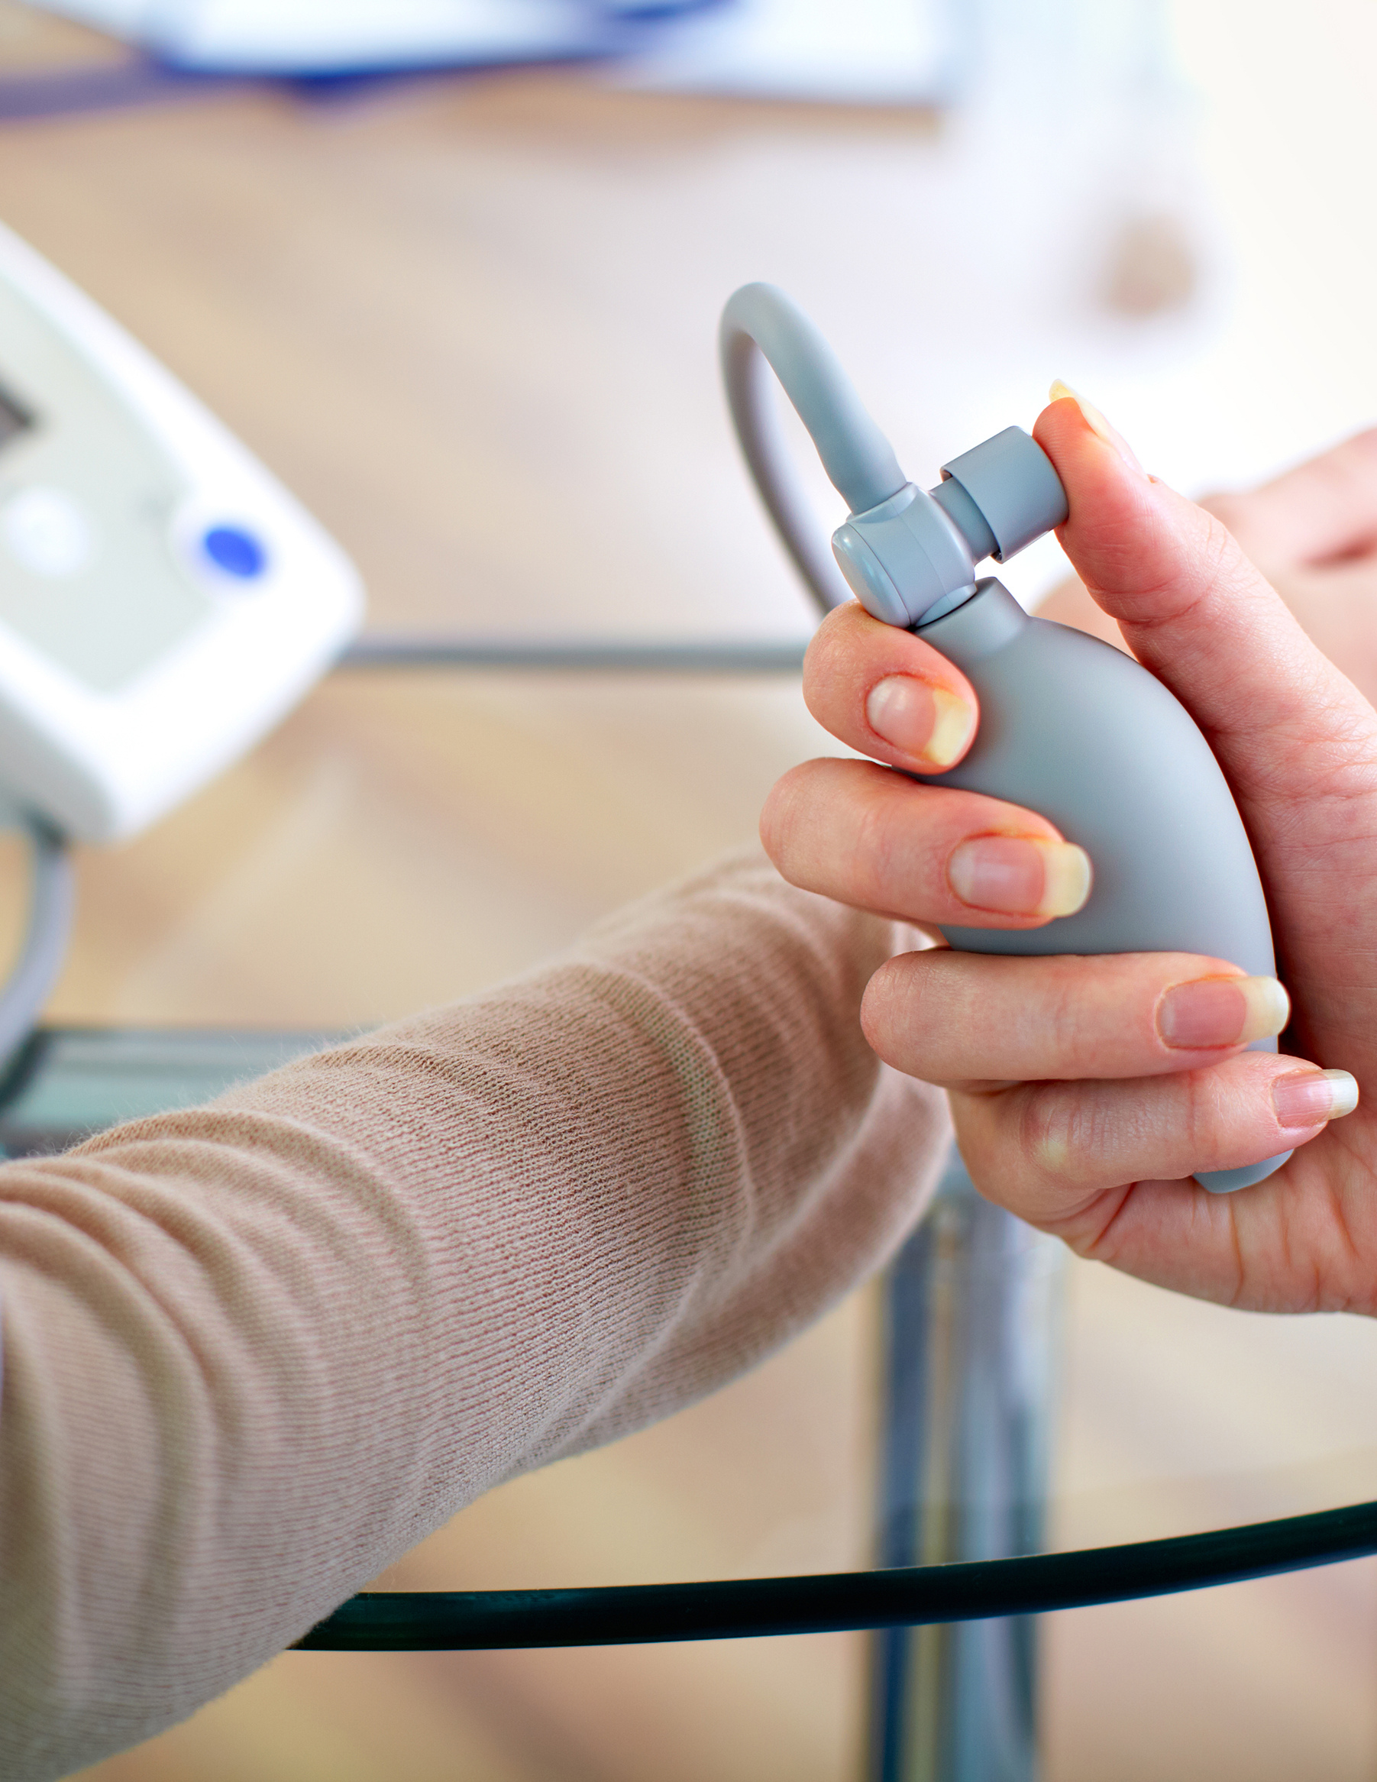
Techniques involved in diabetes care:-
Several AI-based techniques have
been applied in diabetes care. With
the advent of AI, the diagnosis of
diabetes has evolved beyond a few
measurements of blood glucose
levels and glycosylated hemoglobin
(HbA1c).
Case-based reasoning (CBR).
CBR, an AI technique to solve
new problems based on learning
from similar past encounters, is
being extensively used in diabetes
management.
Support System is an example of
CBR that has been used in diabetes
care. The system aims to automatically detect problems in control of
blood glucose, propose solutions to
the detected problems, and remember the effective and ineffective solutions for individual patients.17 CBR has been
used to optimize and individualize insulin therapy for various
meal situations in diabetes.19
Machine learning and deep learning. Several machine

Slide 4
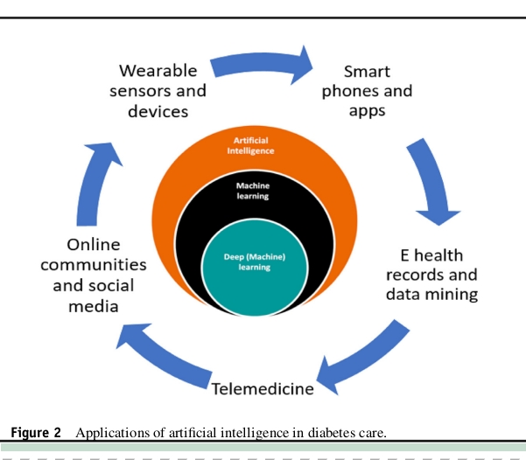

Slide 5
Application:-
Telehealth has revolutionized the
management of diabetes. Remote monitoring reduces the time
spent in follow-up visits and allows a more real-time monitoring of the glycemic status as well as the overall health of the
patient. AI has the ability to replace 50%-70% of routine follow-up clinical consultations with virtual engagements and
remote monitoring.12 Short message service (SMS) text messaging are being tested for improvement in medication adherence in a randomized control trail in over 800 patients with
type 2 diabetes mellitus in sub-Saharan Africa

Slide 6
Algorithm:
• Choose the number of clusters(K) and obtain the data points
• Place the centroids c_1, c_2, ..... c_k randomly
• Steps 4 and 5 should be repeated until the end of a fixed number of iterations
• For each data point x_i:
-find the nearest centroid(c_1, c_2 ,..c_k)
-assign the point to that cluster
• for each cluster j = 1..k
new centroid = mean of all points assigned to that cluster
• End
iv.Model Building

Slide 7
THANK YOU！

